Slide 1
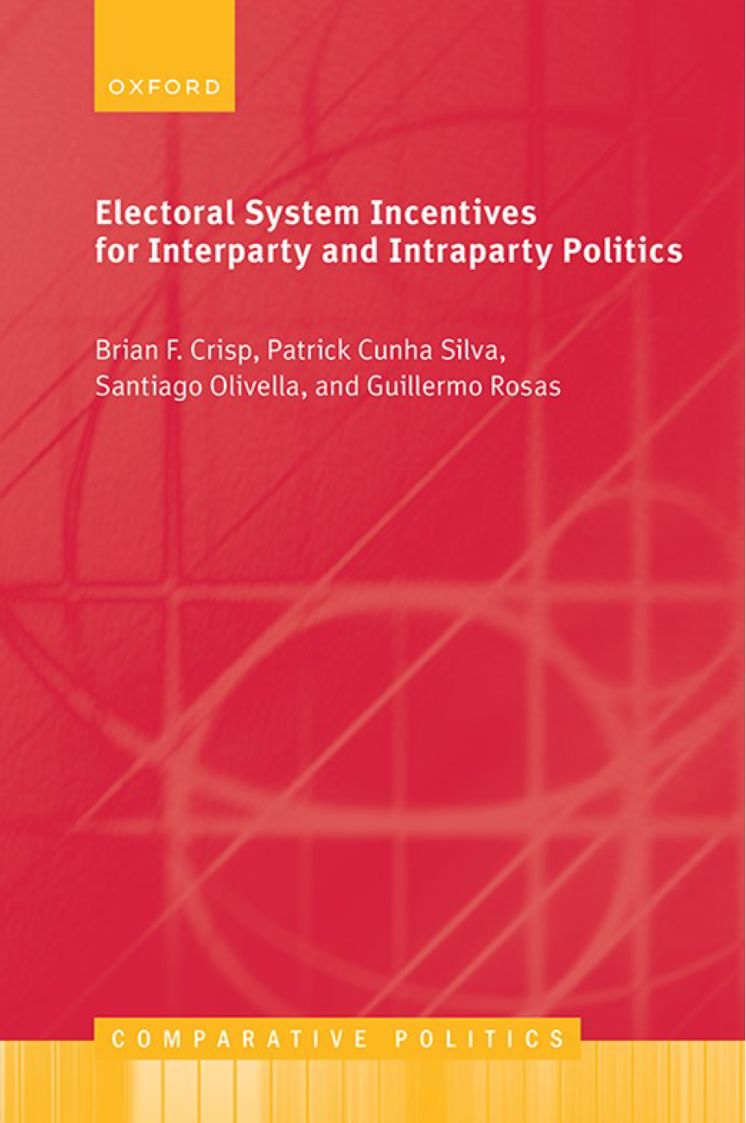

Slide 2
Electoral System Incentives for Interparty and Intraparty Politics
Brian F. Crisp, Patrick Cunha Silva, Santiago Olivella, Guillermo Rosas

Slide 3
Part I: Rules of the Game
1. Party Politics
2. Electoral Rules
3. Electoral Systems

Slide 4
Party Politics
1.1 The Politics of Interparty Competition
1.2 The Politics of Intraparty Competition
1.3 The Two-Dimensional Interparty–Intraparty Space
1.4 Structure of the Book
1.5 Products From the Larger Project
1.6 Rationale, Scope, and Likely Readership

Slide 5
The Politics of Interparty Competition

Slide 6
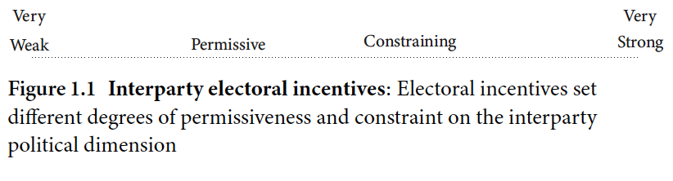
1.1 Interparty electoral incentives

Slide 7
The Politics of Intraparty Competition

Slide 8
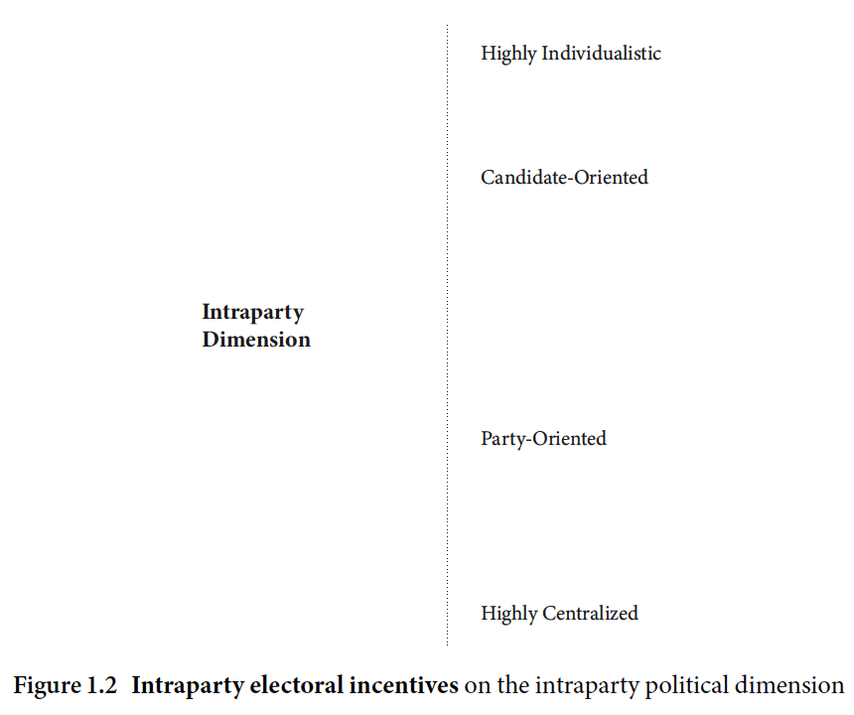
1.2 Intraparty Electoral Incentives

Slide 9
The Two-Dimensional Interparty–Intraparty Space

Slide 10
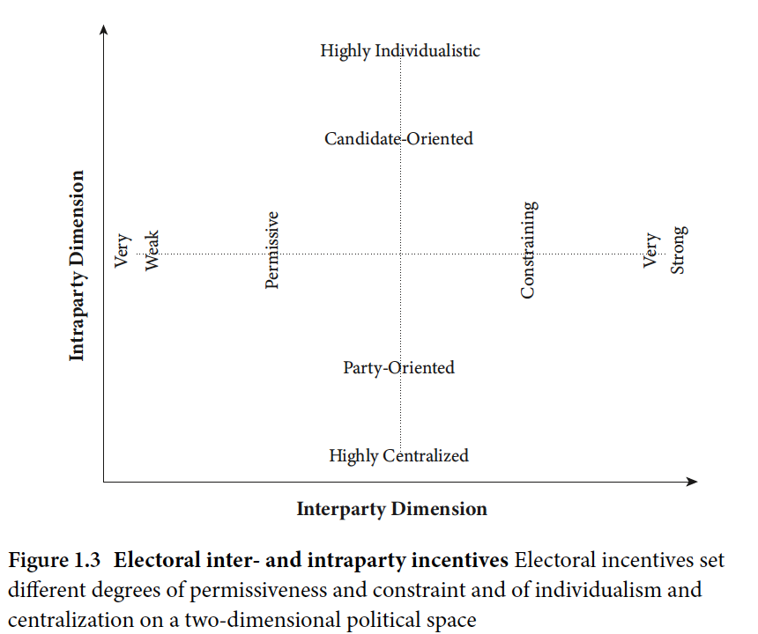
1.3 Electoral inter- and intraparty incentives

Slide 11
Structure of the Book

Slide 12
Products From the Larger Project

Slide 13
Rationale, Scope, and Likely Readership

Slide 14
Electoral Rules
2.1 The Component Rules of Electoral Systems
2.1.1 Rules Frequently Thought to Shape Interparty Incentives
2.1.2 Rules Frequently Thought to Shape Intraparty Incentives
2.2 Summary

Slide 15
The Component Rules of Electoral Systems
2.1.1 Rules Frequently Thought to Shape Interparty Incentives
2.1.2 Rules Frequently Thought to Shape Intraparty Incentives

Slide 16
Rules Frequently Thought to Shape Interparty Incentives

Slide 17
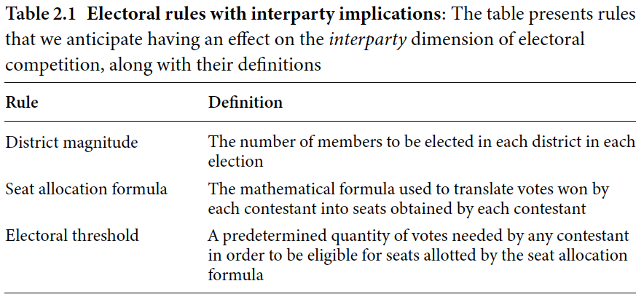
2.1 Electoral rules with interparty implications

Slide 18
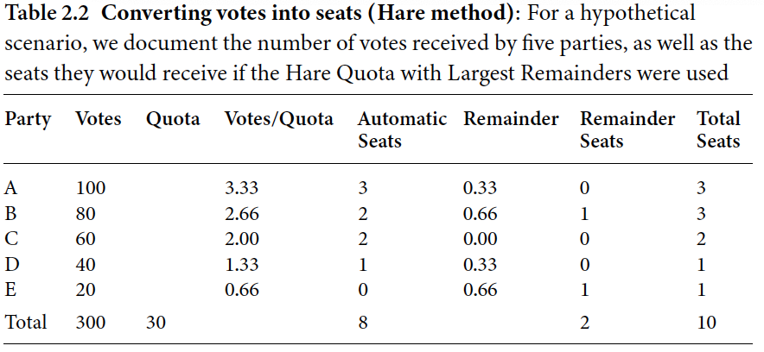
2.2 Converting votes into seats (Hare method)

Slide 19
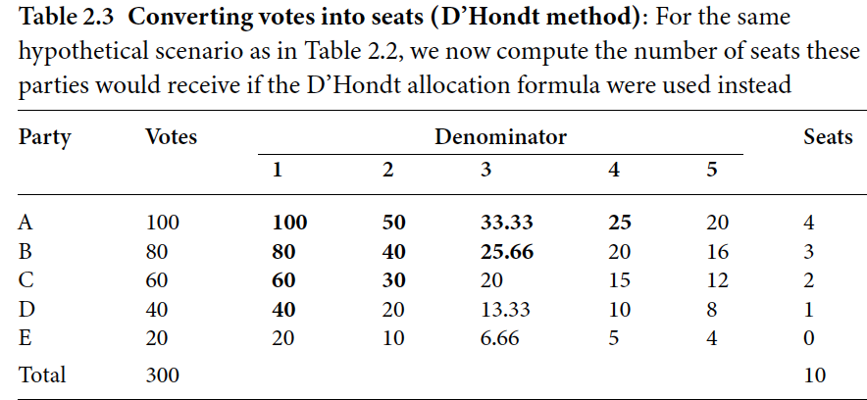
2.3 Converting votes into seats (D’Hondt method)

Slide 20
Rules Frequently Thought to Shape Intraparty Incentives

Slide 21
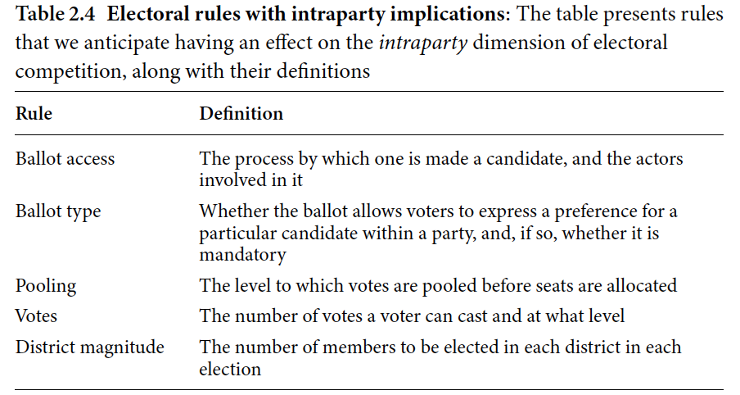
2.4 Electoral rules with intraparty implications

Slide 22
Summary

Slide 23
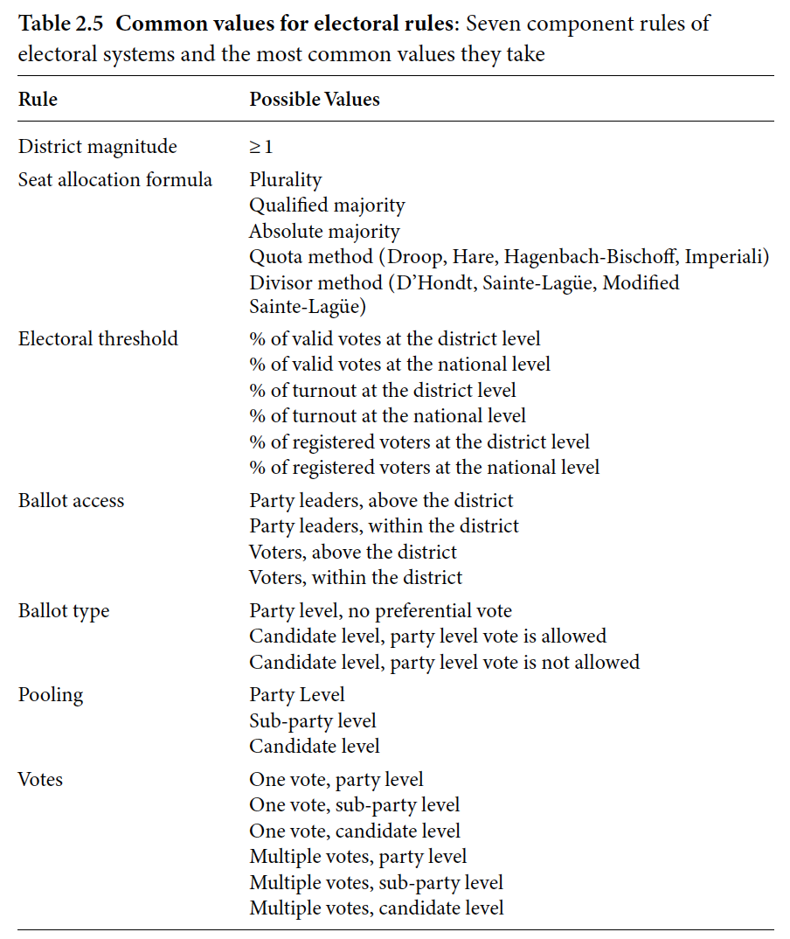
2.5 Common values for electoral rules

Slide 24
Electoral Systems
3.1 Electoral System Families
3.2 The Proportional Representation Family
3.3 The Majoritarian/Pluralitarian Family
3.4 The Mixed-Member Family
3.5 Conclusion

Slide 25
Electoral System Families

Slide 26
The Proportional Representation Family

Slide 27
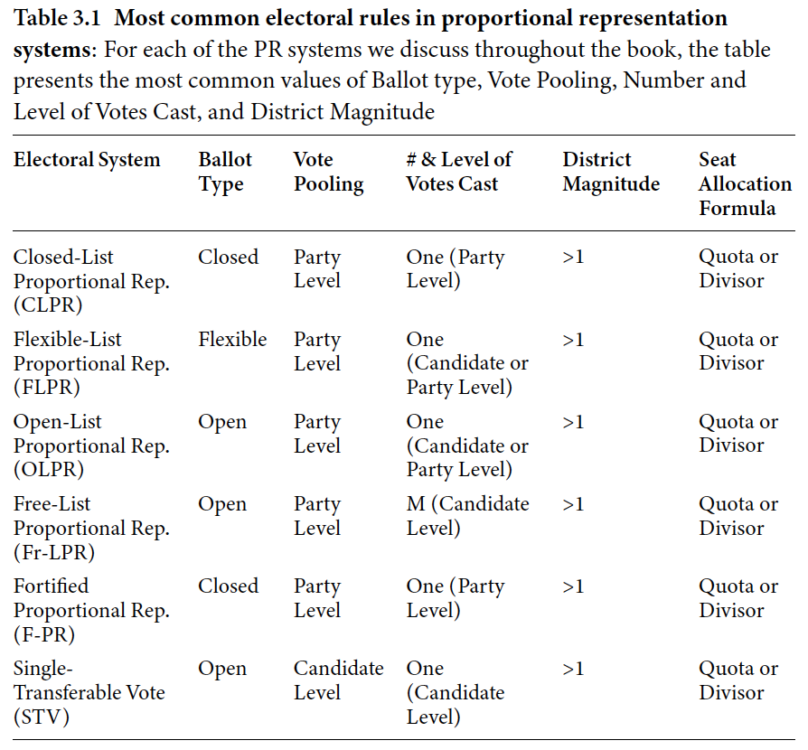
3.1 Most common electoral rules in proportional representation systems

Slide 28
The Majoritarian/Pluralitarian Family

Slide 29
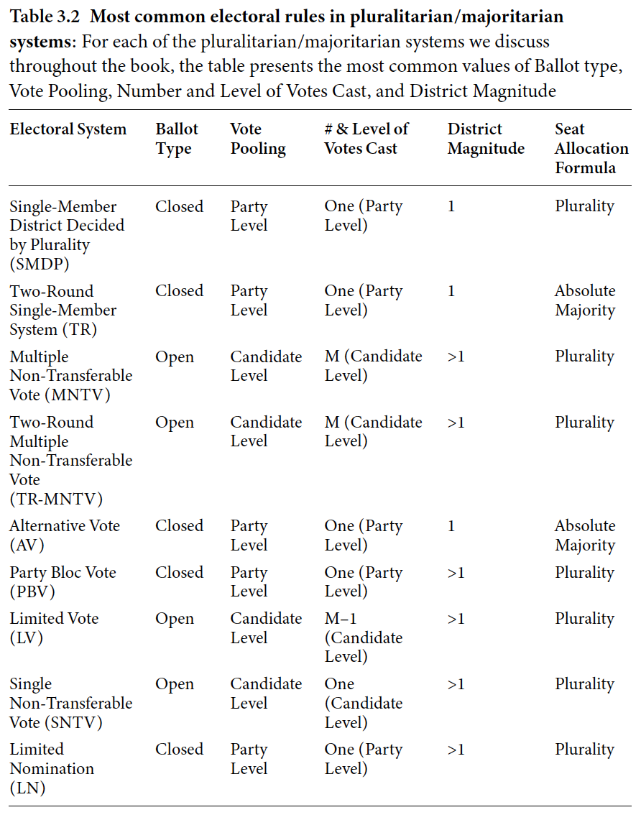
3.2 Most common electoral rules in pluralitarian/majoritarian systems

Slide 30
The Mixed-Member Family

Slide 31
Conclusion

Slide 32
Part II: Incentives in the I-I Space
4. Simulating the Effect of Electoral System Incentives
5. Component Rules and Interparty and Intraparty Incentives
6. Placing “Real-World” Electoral Systems in the I–I Space

Slide 33
Simulating the Effect of Electoral System Incentives
4.1 A Simulated World
4.2 Our Approach
4.3 Algorithmic Elections
4.3.1 Our Quantities of Interest
4.3.2 The Interparty and Intraparty Incentives of Electoral Systems
4.4 Other Potential Uses for the Simulation Approach

Slide 34
A Simulated World

Slide 35
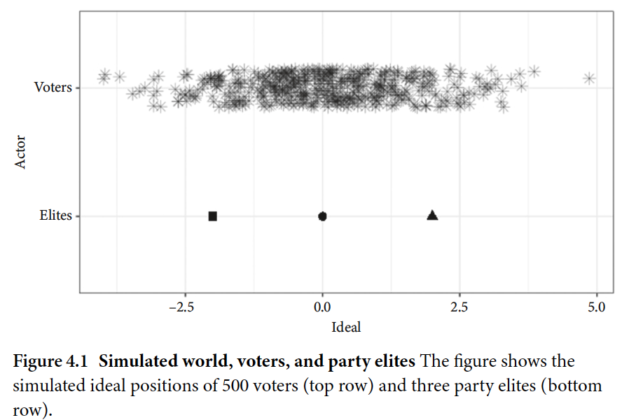
4.1 Simulated world, voters, and party elites

Slide 36
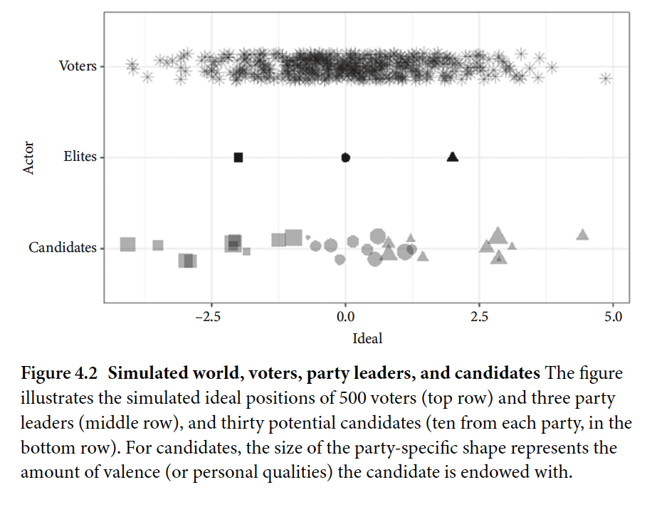
4.2 Simulated world, voters, party leaders, and candidates

Slide 37
Our Approach

Slide 38
Algorithmic Elections
4.3.1 Our Quantities of Interest
4.3.2 The Interparty and Intraparty Incentives of Electoral Systems

Slide 39
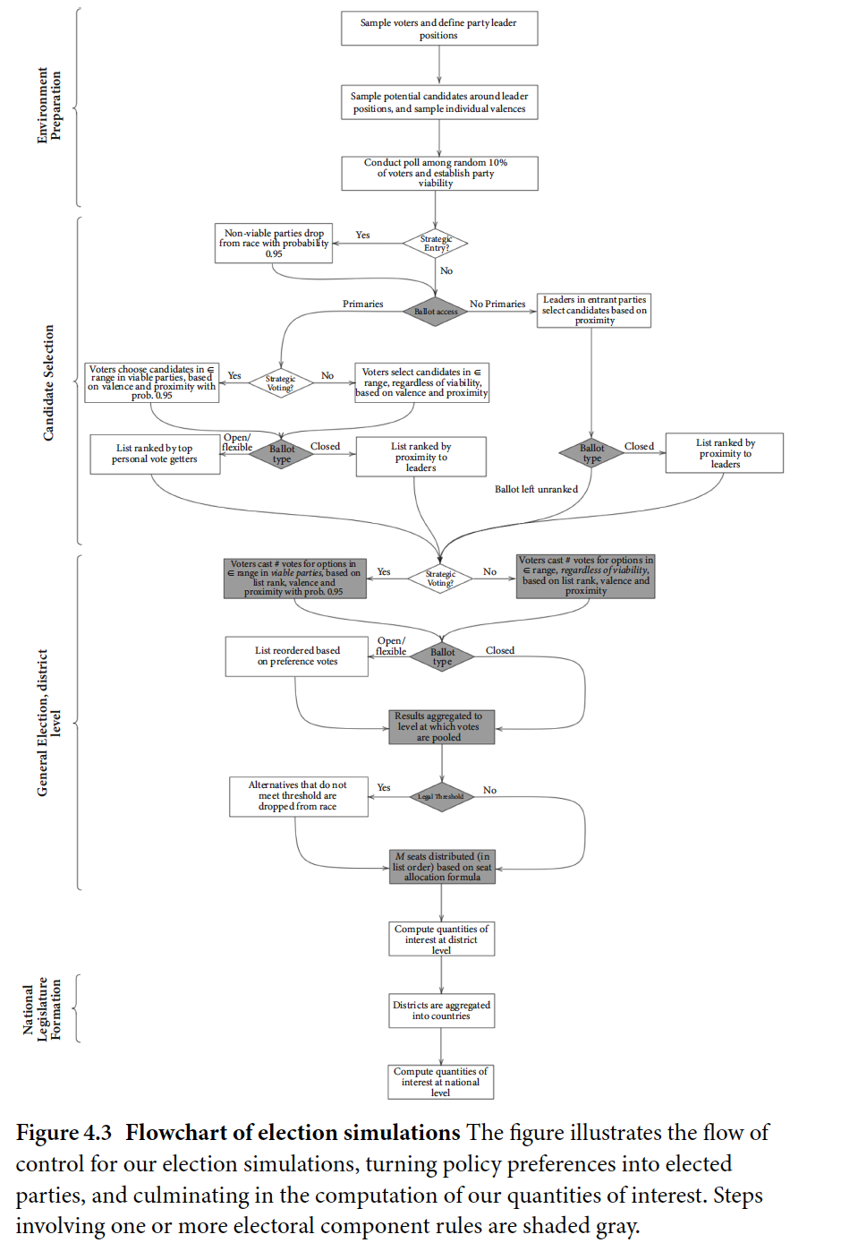
4.3 Flowchart of election simulations

Slide 40
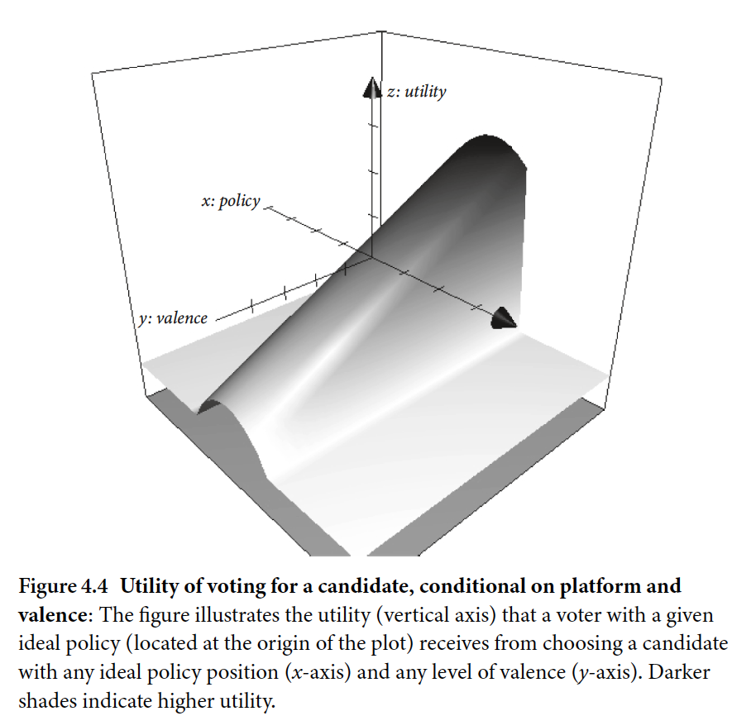
4.4 Utility of voting for a candidate, conditional on platform and valence

Slide 41
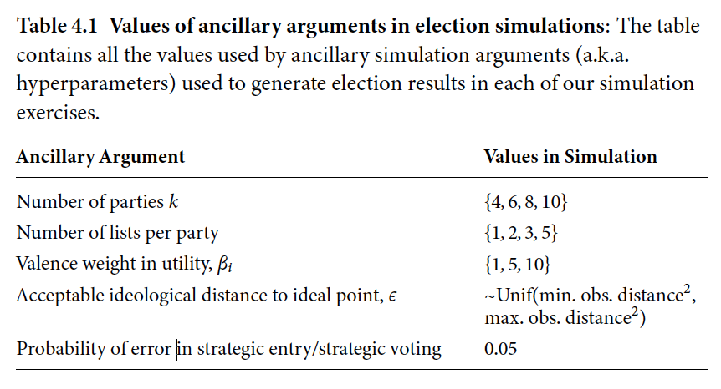
4.1 Values of ancillary arguments in election simulations

Slide 42
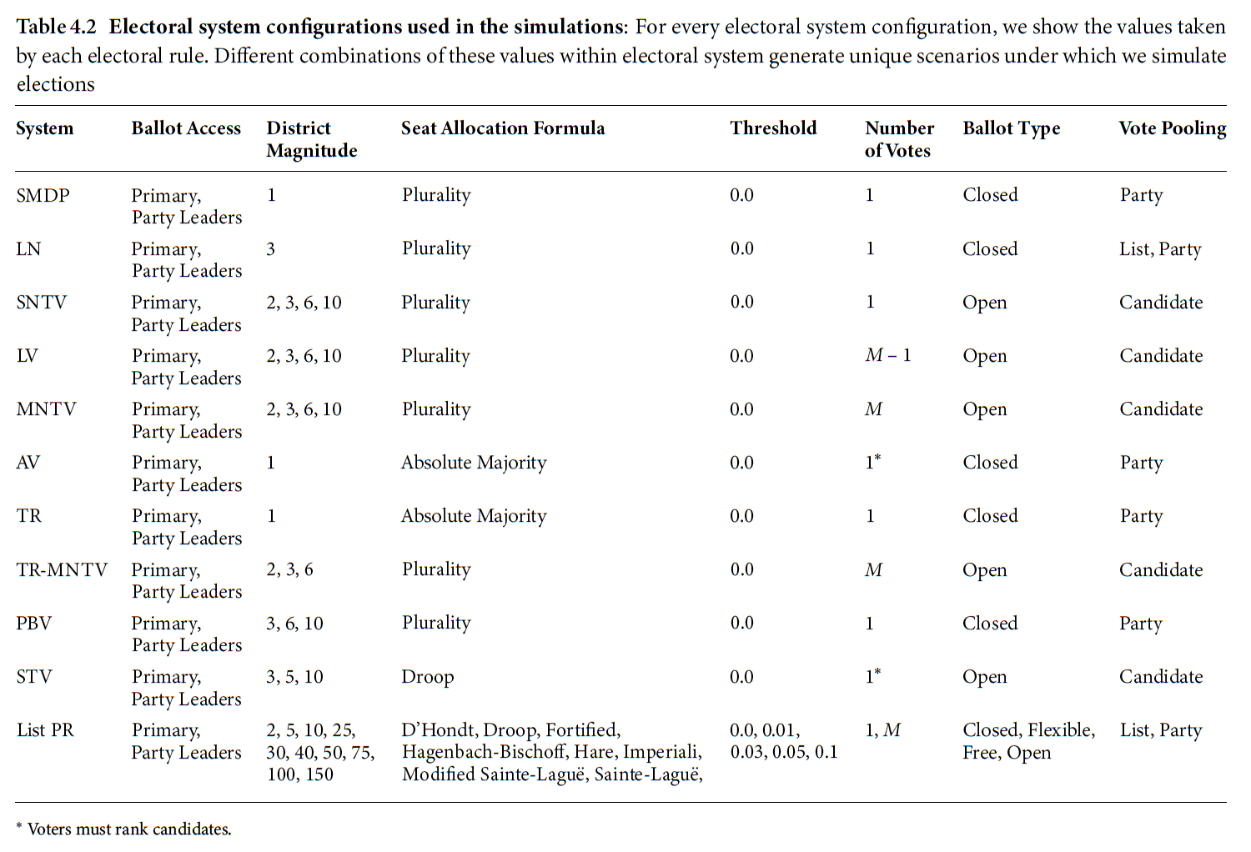
4.2 Electoral system cofigurations used in the simulations

Slide 43
Our Quantities of Interest

Slide 44
The Interparty and Intraparty Incentives of Electoral Systems

Slide 45
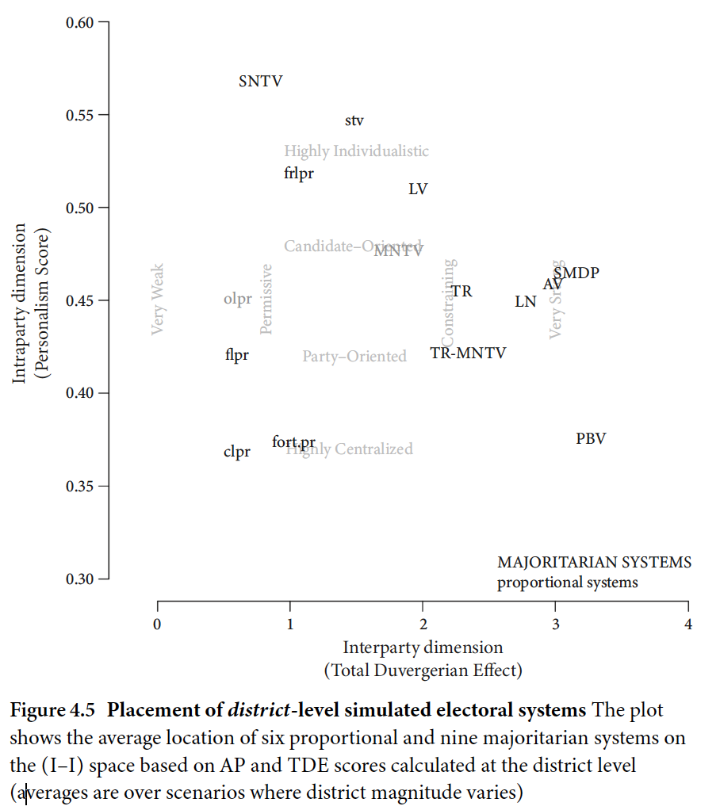
4.5 Placement of district-level simulated electoral systems

Slide 46
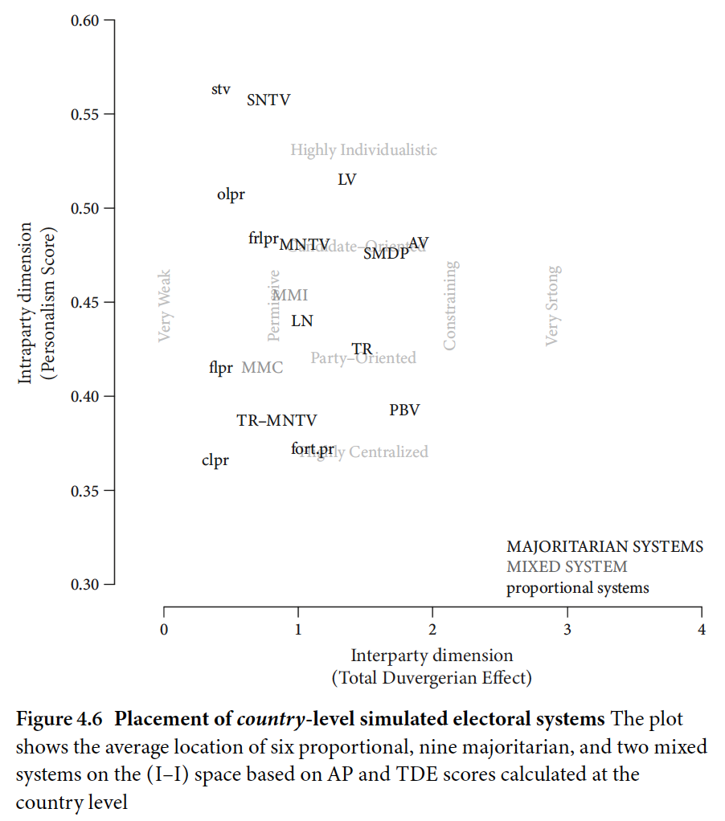
4.6 Placement of country-level simulated electoral systems

Slide 47
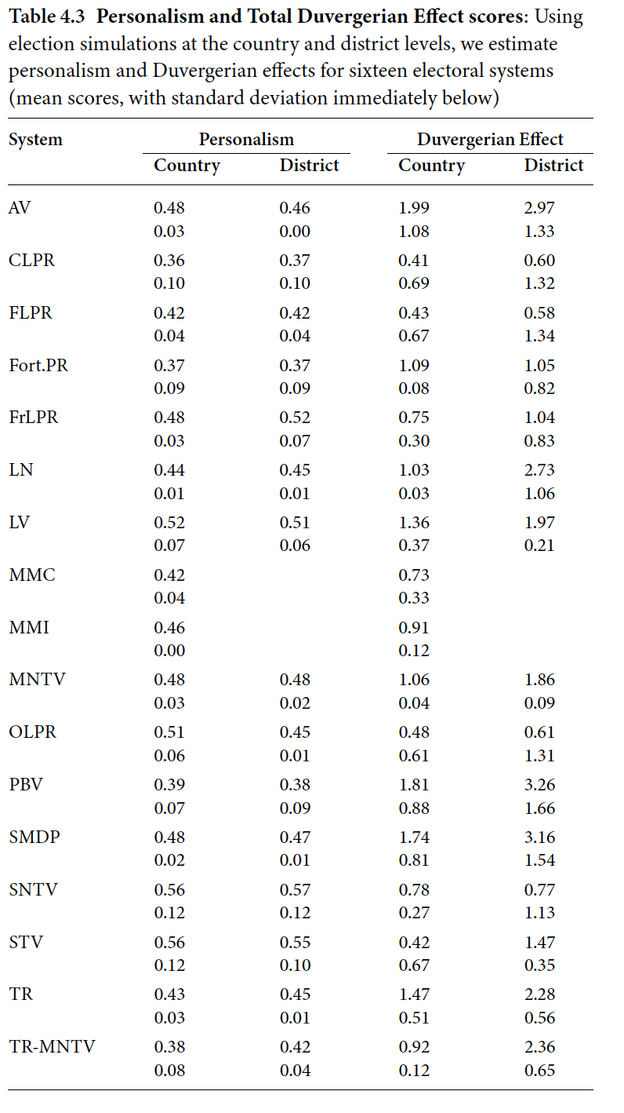
4.3 Personalism and Total Duvergerian Effect scores

Slide 48
Other Potential Uses for the Simulation Approach

Slide 49
Component Rules and Interparty and Intraparty Incentives
5.1 The Marginal Effects of Component Rules on TDE
5.1.1 District Magnitude
5.1.2 Seat Allocation Formula
5.1.3 Electoral Threshold
5.2 Marginal Effects of Component Rules on AP
5.2.1 Ballot Type
5.2.2 Number and Level of Votes
5.2.3 District Magnitude and Ballot Type
5.3 Accounting for Negative TDE Scores
5.4 Conclusion

Slide 50
The Marginal Effects of Component Rules on TDE
5.1.1 District Magnitude
5.1.2 Seat Allocation Formula
5.1.3 Electoral Threshold

Slide 51
District Magnitude

Slide 52
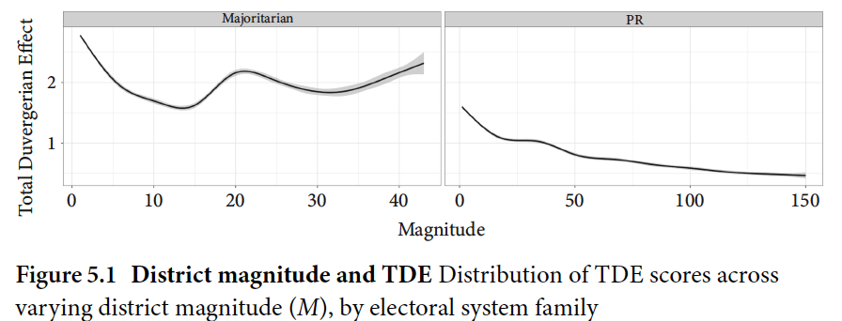
5.1 District magnitude and TDE

Slide 53
Seat Allocation Formula

Slide 54
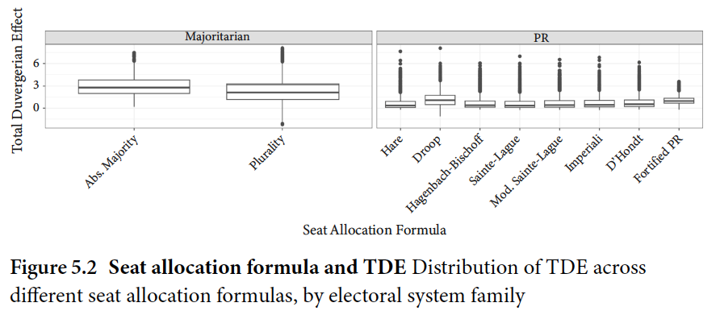
5.2 Seat allocation formula and TDE

Slide 55
Electoral Threshold

Slide 56
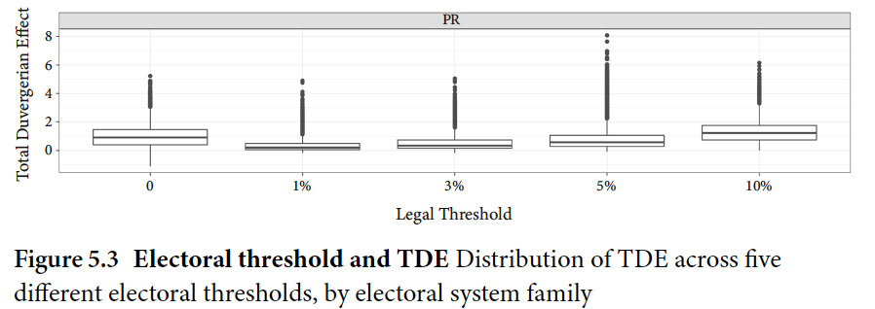
5.3 Electoral threshold and TDE

Slide 57
Marginal Effects of Component Rules on AP
5.2.1 Ballot Type
5.2.2 Number and Level of Votes
5.2.3 District Magnitude and Ballot Type

Slide 58
Ballot Type

Slide 59
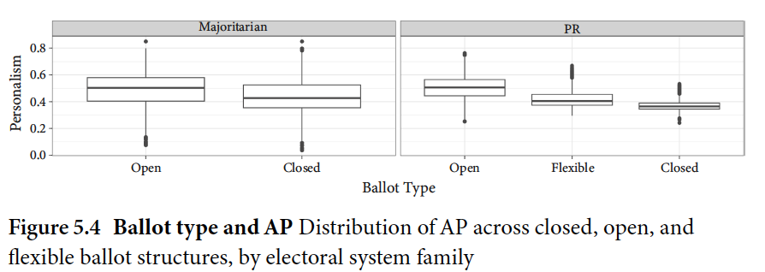
5.4 Ballot type and AP

Slide 60
Number and Level of Votes

Slide 61
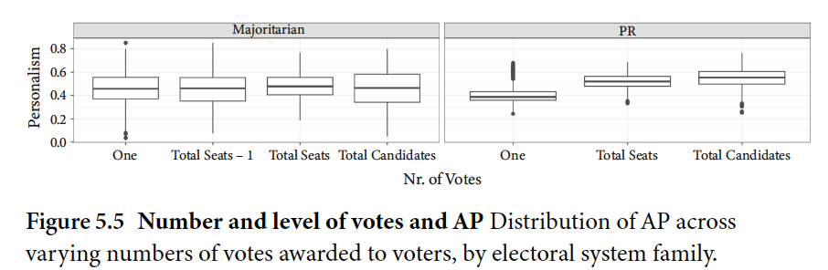
5.5 Number and level of votes and AP

Slide 62
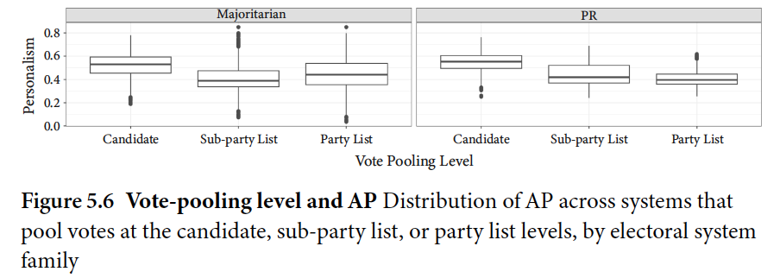
5.6 Vote-pooling level and AP

Slide 63
District Magnitude and Ballot Type

Slide 64
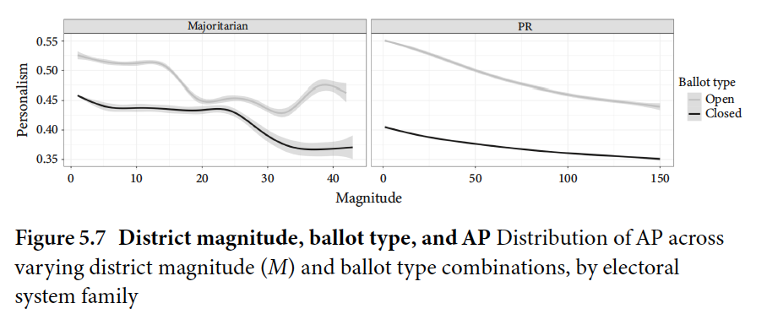
5.7 District magnitude, ballot type, and AP

Slide 65
Accounting for Negative TDE Scores

Slide 66
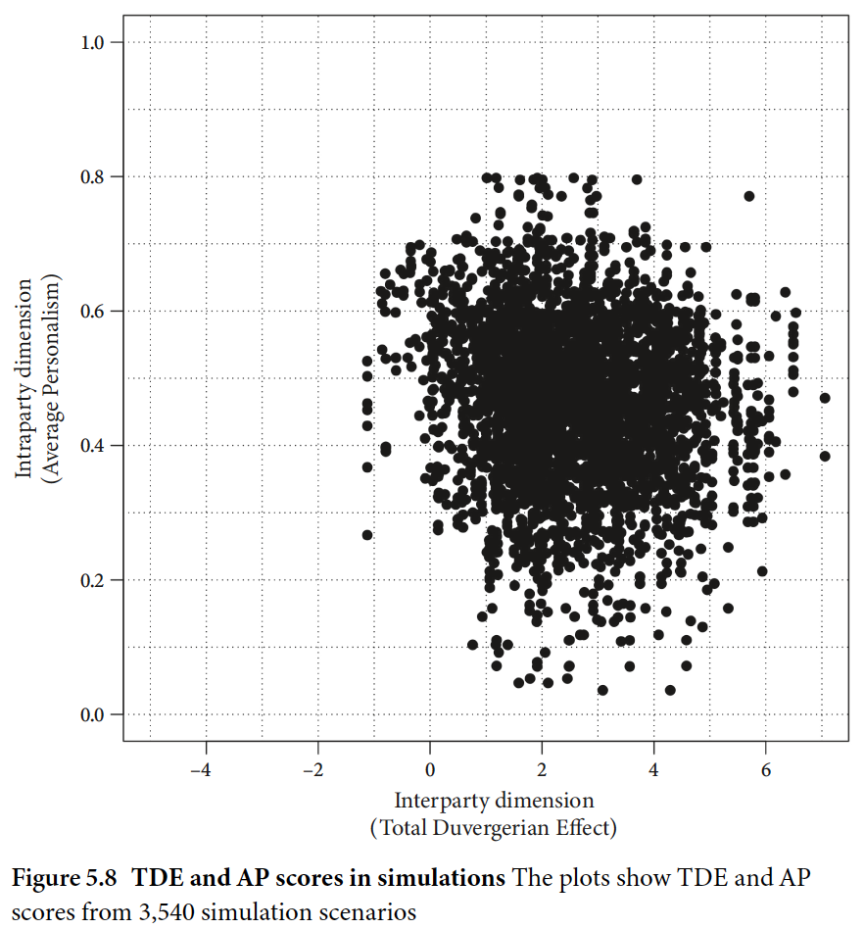
5.8 TDE and AP scores in simulations

Slide 67
Conclusion

Slide 68
Placing “Real-World” Electoral Systems in the I–I Space
6.1 A Tale of Three Electoral Systems
6.2 Electoral Systems on the I–I Space
6.2.1 Mapping Democracies
6.2.2 Mapping Archetypal Cases
6.3 Introducing the I³ dashboard
6.4 Conclusion

Slide 69
A Tale of Three Electoral Systems

Slide 70
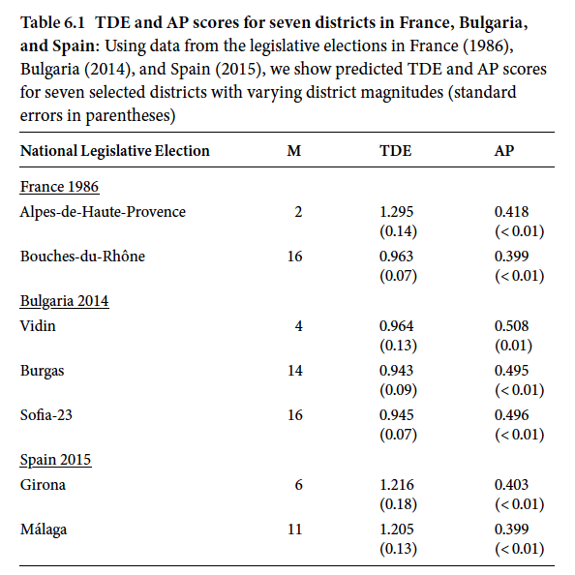
6.1 TDE and AP scores for seven districts in France, Bulgaria, and Spain

Slide 71
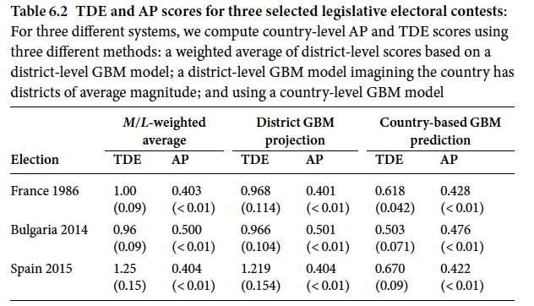
6.2 TDE and AP scores for three selected legislative electoral contests

Slide 72
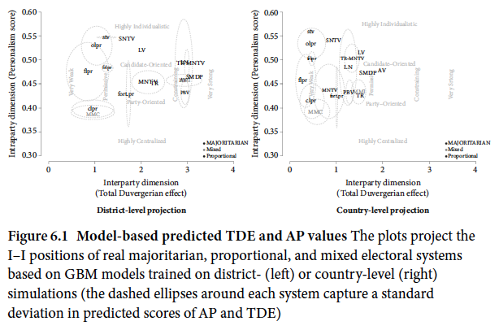
6.1 Model-based predicted TDE and AP values

Slide 73
Electoral Systems on the I–I Space
6.2.1 Mapping Democracies
6.2.2 Mapping Archetypal Cases

Slide 74
Mapping Democracies

Slide 75
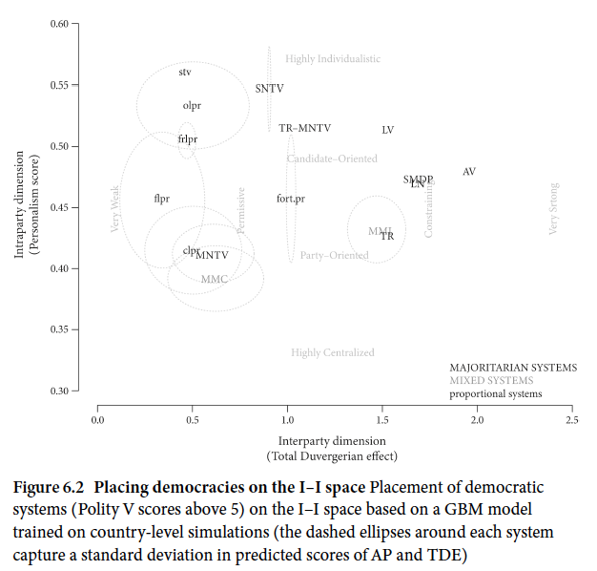
6.2 Placing democracies on the I–I space

Slide 76
Mapping Archetypal Cases

Slide 77
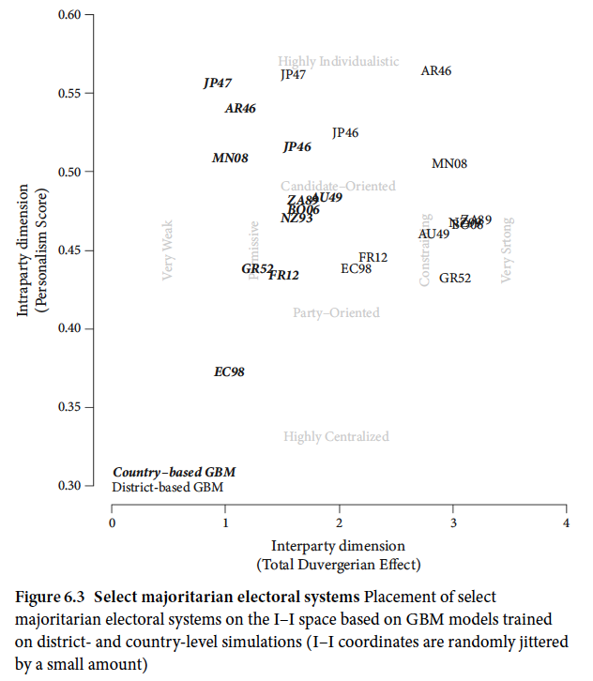
6.3 Select majoritarian electoral systems

Slide 78
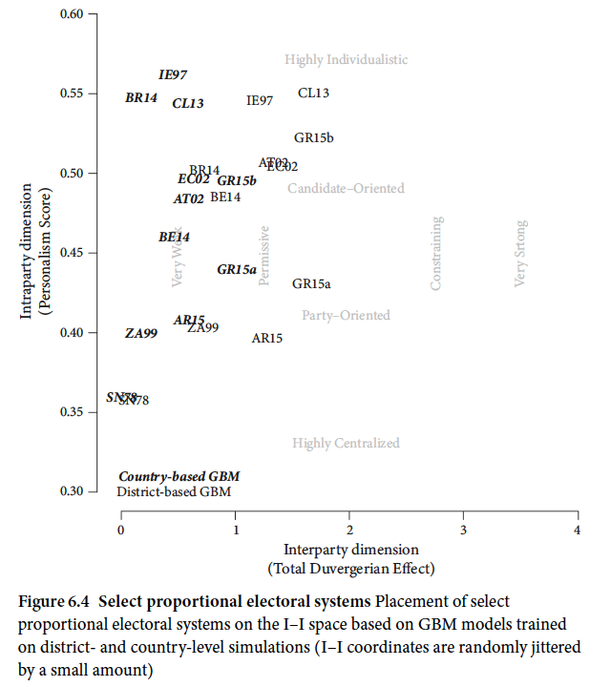
6.4 Select proportional electoral systems

Slide 79
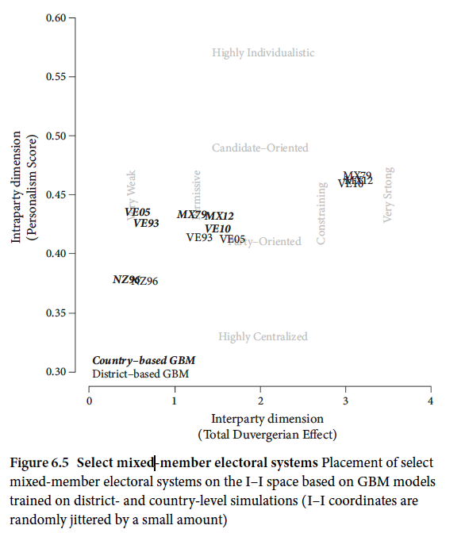
6.5 Select mixed-member electoral systems

Slide 80
Introducing the I³ dashboard

Slide 81
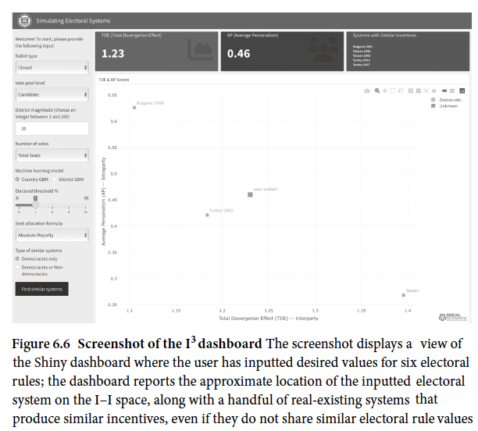
6.6 Screenshot of the I Shiny dashboard

Slide 82
Conclusion

Slide 83
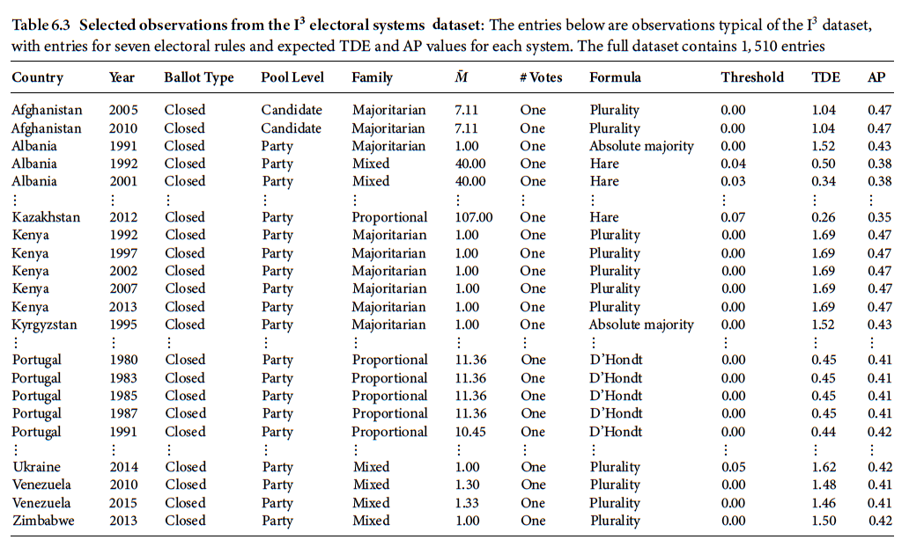
6.3 Selected observations from the I electoral systems Dataset

Slide 84
PART III INTERPARTY POLITICS
7. The Size of the Party System
8. The Distribution of Partisan Ideological Locations
9. Congruence

Slide 85
The Size of the Party System
7.1 The Effective Number of Parties
7.2 TDE and N
7.3 Conclusion

Slide 86
The Effective Number of Parties

Slide 87
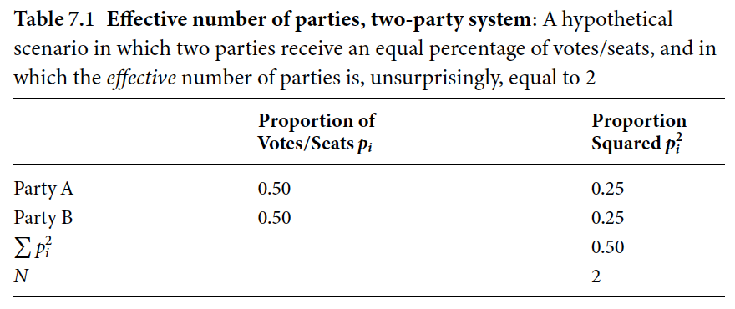
7.1 Effective number of parties, two-party system

Slide 88
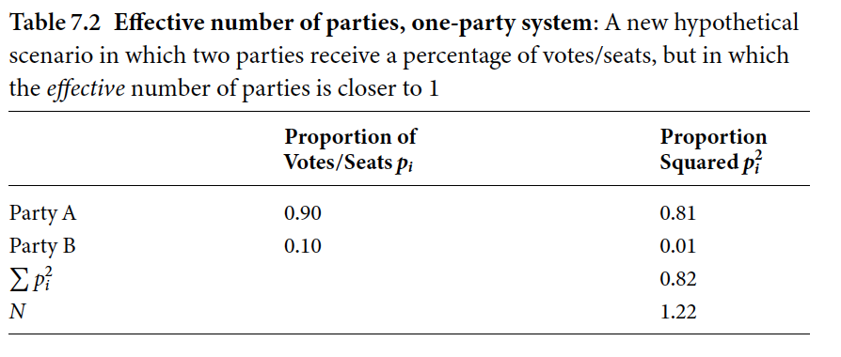
7.2 Effective number of parties, one-party system

Slide 89
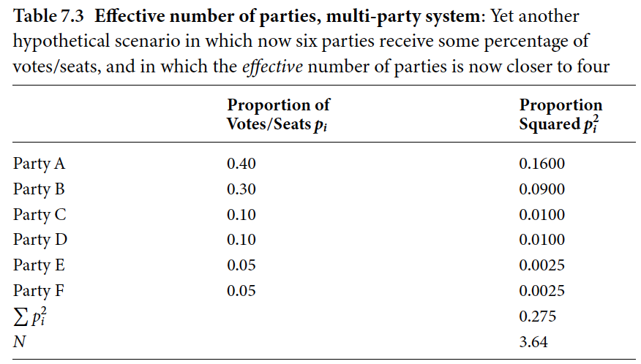
7.3 Effective number of parties, multi-party system

Slide 90
TDE and N

Slide 91
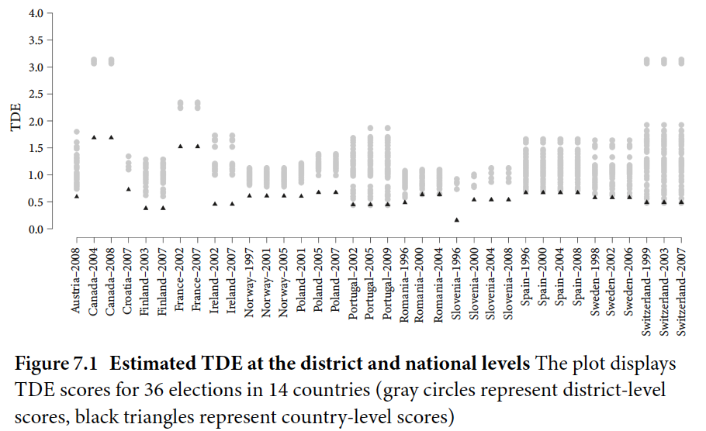
7.1 Estimated TDE at the district and national levels

Slide 92
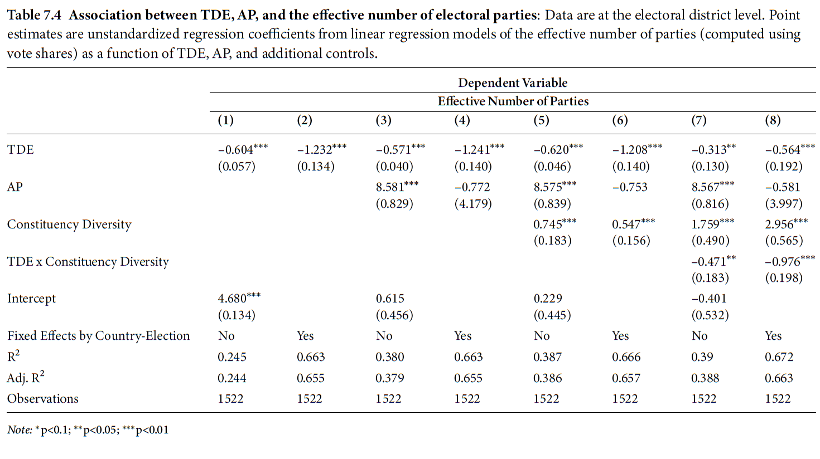
7.4 Association between TDE, AP, and the effective number of electoral parties

Slide 93
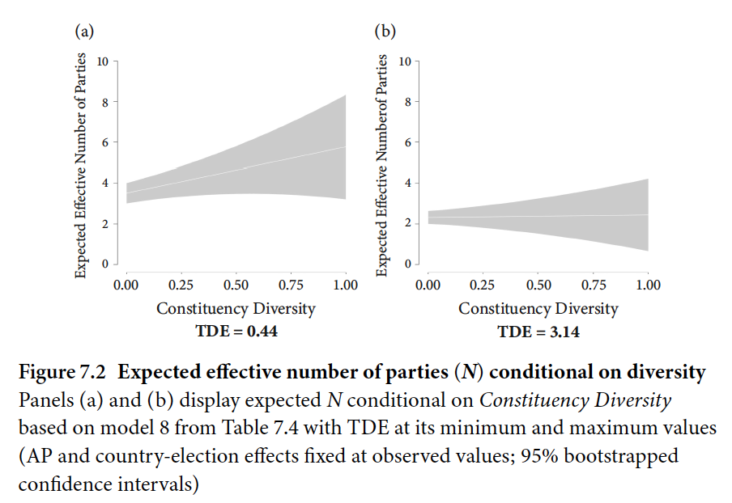
7.2 Expected effective number of parties (N) conditional on diversity

Slide 94
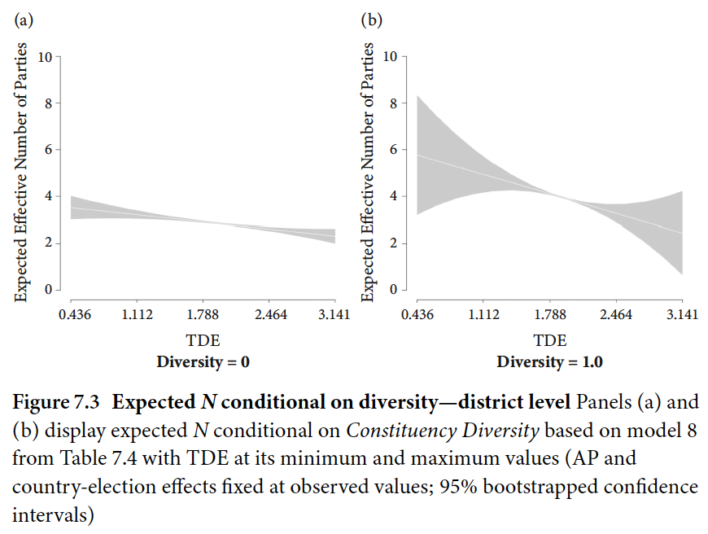
7.3 Expected N conditional on diversity—district level

Slide 95
Conclusion

Slide 96
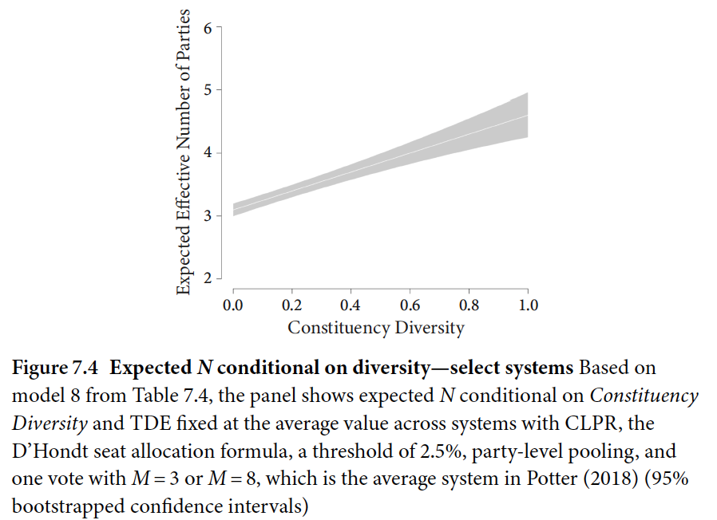
7.4 Expected conditional on diversity—select systems

Slide 97
The Distribution of Partisan Ideological Locations
8.1 Party Dispersion and Electoral Systems
8.2 Identifying Party Locations
8.3 Measuring Dispersion and Concentration
8.3.1 Dispersion and Polarization
8.3.2 Dispersion and Social Heterogeneity
8.4 TDE and Party System Dispersion
8.5 Conclusion

Slide 98
Party Dispersion and Electoral Systems

Slide 99
Identifying Party Locations

Slide 100
Measuring Dispersion and Concentration
Dispersion and Polarization
Dispersion and Social Heterogeneity

Slide 101
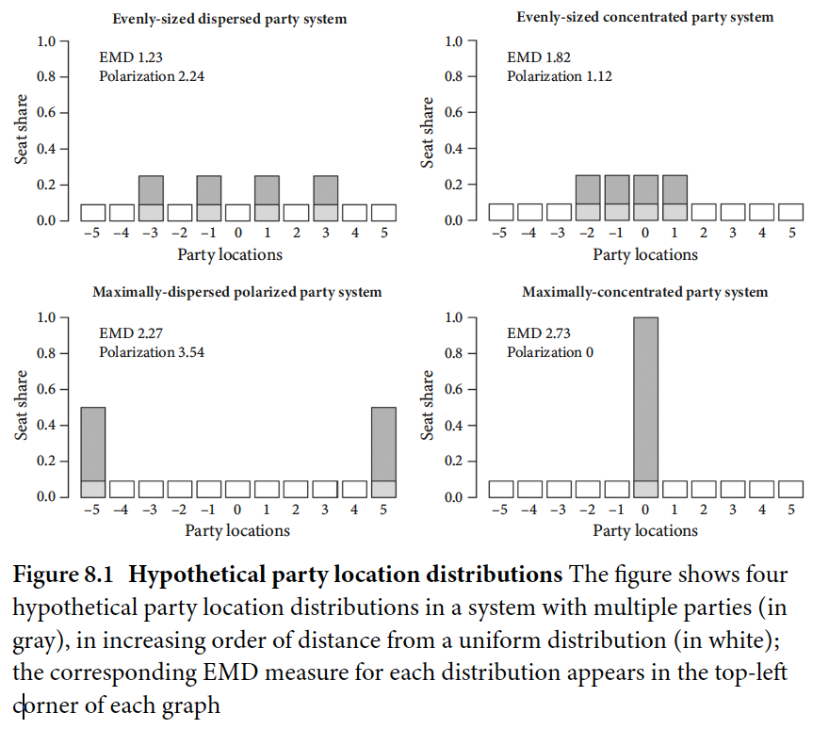
8.1 Hypothetical party location distributions

Slide 102
Dispersion and Polarization

Slide 103
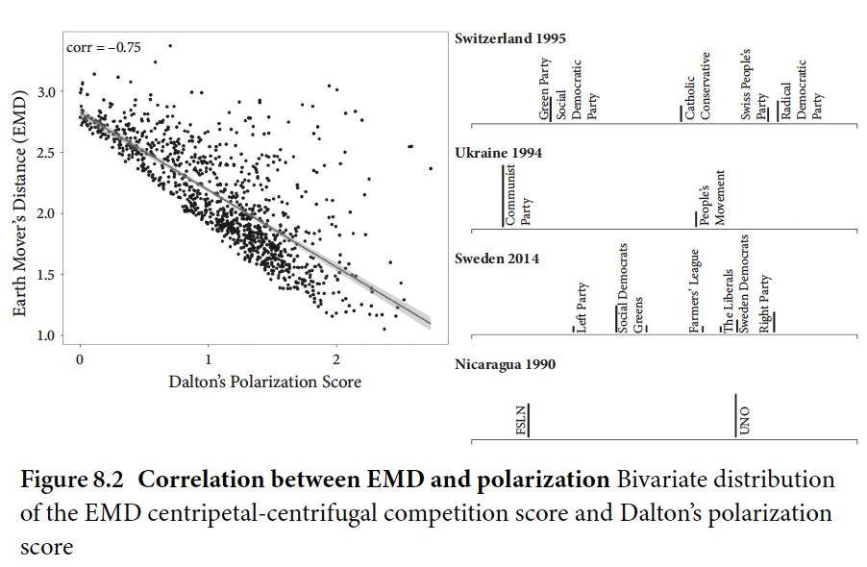
8.2 Correlation between EMD and polarization

Slide 104
Dispersion and Social Heterogeneity

Slide 105
TDE and Party System Dispersion

Slide 106
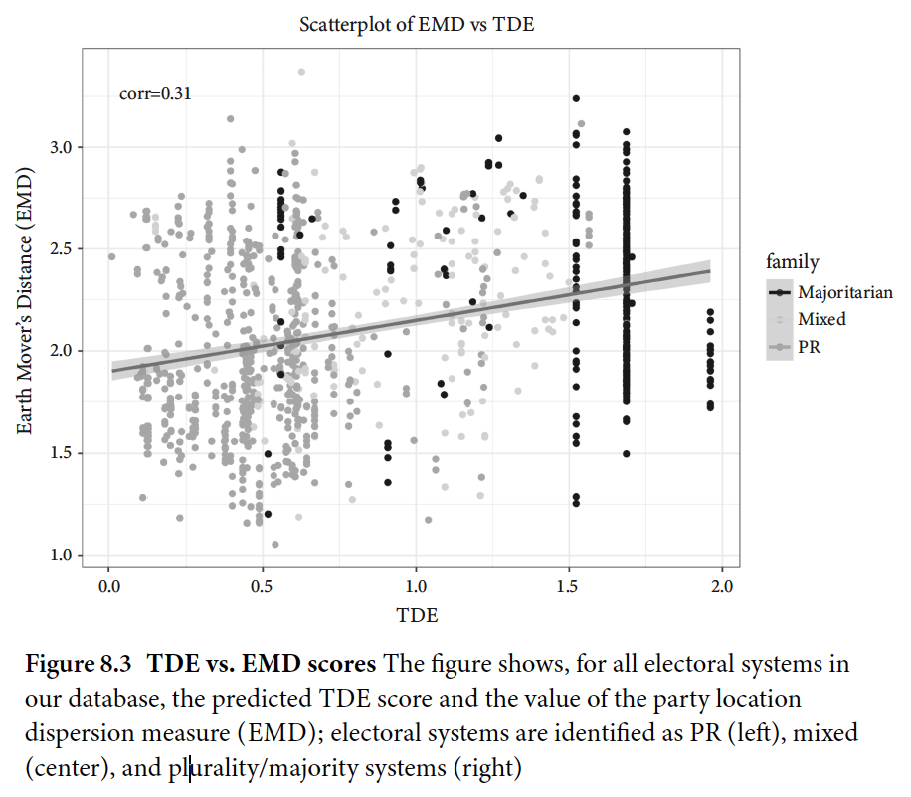
8.3 TDE vs. EMD scores

Slide 107
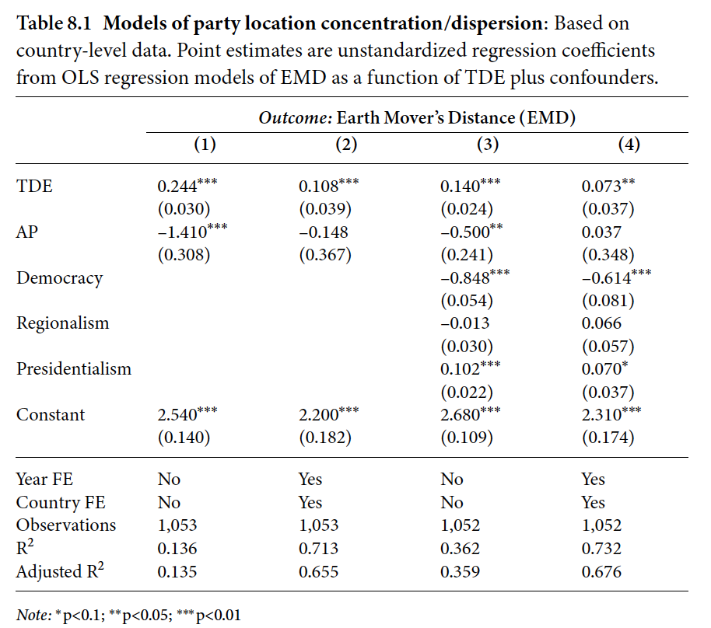
8.1 Models of party location concentration/dispersion

Slide 108
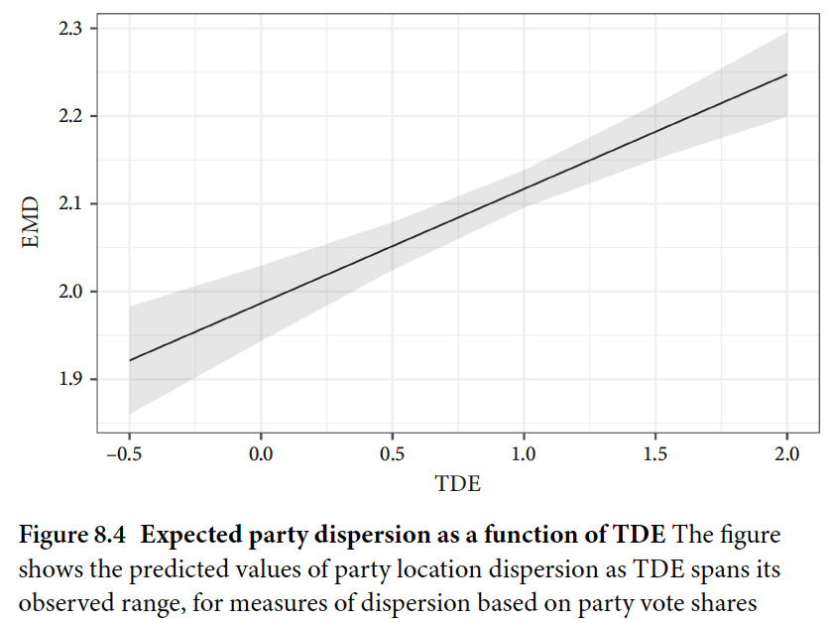
8.4 Expected party dispersion as a function of TDE

Slide 109
Conclusion

Slide 110
Congruence
9.1 Ideological Congruence in Theory and Practice
9.2 Measuring Citizens’ and Politicians’ Preferences
9.3 One-to-One and Many-to-Many Congruence in Latin America
9.4 Results
9.5 Conclusion

Slide 111
Ideological Congruence in Theory and Practice

Slide 112

9.1 Two types of congruence

Slide 113
Measuring Citizens’ and Politicians’ Preferences

Slide 114
One-to-One and Many-to-Many Congruence in Latin America

Slide 115

9.2 A representation of “bridging” responses

Slide 116

9.3 Correlation among two types of congruence

Slide 117
Results

Slide 118

9.1 TDE as predictor of one-to-one congruence

Slide 119

9.2 TDE as predictor of many-to-many congruence

Slide 120

9.4 TDE effect on many-to-many congruence

Slide 121
Conclusion

Slide 122
Part IV: Intraparty Politics
10. Campaigns for Office
11. Constituency Service
12. Committee Systems and Assignments
13. Party Unity
14. Programmatic Policy or Pork Barrel

Slide 123
Campaigns for Office
10.1 Intensity, Complexity, Cash, and Focus
10.2 Campaigns and AP
10.3 Conclusion

Slide 124
Intensity, Complexity, Cash, and Focus

Slide 125
Campaigns and AP

Slide 126

10.1 Attention to Candidate

Slide 127

10.1 Association between AP and campaign focus

Slide 128

10.2 Expected attention to candidate

Slide 129

10.3 Expected Attention to Candidate, AP, and district magnitude

Slide 130
Conclusion

Slide 131
Constituency Service
11.1 Directly Observed v. Self-Reported Indicators of Constituency Service
11.2 Empirical Analysis
11.2.1 Building a Constituency Service Score
11.2.2 Results
11.3 Conclusion

Slide 132
Directly Observed v. Self-Reported Indicators of Constituency Service

Slide 133
Empirical Analysis
11.2.1 Building a Constituency Service Score
11.2.2 Results

Slide 134

11.1 PARTIREP items related to constituency service

Slide 135

11.1 Constituency service factor loadings

Slide 136
Building a Constituency Service Score

Slide 137

11.2 Constituency service factor scores

Slide 138
Results

Slide 139

11.2 Association between AP and constituency service

Slide 140

11.3 AP and constituency service

Slide 141

11.4 Constituency service, district magnitude and ballot type

Slide 142
Conclusion

Slide 143
Committee Systems and Assignments
12.1 Intraparty Incentives and Committees
12.2 The Size of the Committee System
12.3 Assignment of MPs and MCs to Committees
12.4 Conclusion

Slide 144
Intraparty Incentives and Committees

Slide 145
The Size of the Committee System

Slide 146

12.1 Distribution of number of committees

Slide 147

12.1 Predictors of number of legislative committees

Slide 148

12.2 Effect of AP on number of committees

Slide 149
Assignment of MPs and MCs to Committees

Slide 150

12.2 Predictors of legislator membership in distributive committees

Slide 151

12.3 AP effect on distributive committee membership

Slide 152
Conclusion

Slide 153
Party Unity
13.1 Sources of Unity
13.2 Observing Party Unity
13.3 Party Disunity and Electoral System Incentives
13.4 Conclusion

Slide 154
Sources of Unity

Slide 155
Observing Party Unity

Slide 156

13.1 Retweet networks in The Netherlands, France, and Slovenia

Slide 157

13.2 Within and across party retweet connections

Slide 158

13.3 Network of largest parties in Germany

Slide 159

13.4 Disunity induced by legislators in two hypothetical parties

Slide 160

13.5 Party-specific disunity of German legislators

Slide 161

13.6 Disunity scores across countries

Slide 162
Party Disunity and Electoral System Incentives

Slide 163

13.1 Models of party (dis)unity

Slide 164

13.7 Predicted disunity as a function of AP

Slide 165

13.8 Composite prediction of disunity as a function of magnitude

Slide 166
Conclusion

Slide 167
Programmatic Policy or Pork Barrel
14.1 Efforts to Measure the Balance between Programmatic and Pork Barrel Policies
14.2 Pork Barrel and AP
14.2.1 Bill Targets in Honduras
14.3 Conclusion

Slide 168
Efforts to Measure the Balance between Programmatic and Pork Barrel Policies

Slide 169
Pork Barrel and AP
14.2.1 Bill Targets in Honduras

Slide 170
Bill Targets in Honduras

Slide 171

14.1 Before/after reform scores in Honduras

Slide 172

14.1 Association between AP and initiated local goods bills

Slide 173

14.2 Local goods bills distribution across M

Slide 174
Conclusion

Slide 175
Part V: Conclusion
15. Electing to Simulate

Slide 176
Electing to Simulate
15.1 Our Data
15.2 Addressing Theoretically Motivated Extensions
15.3 A Final Re-Statement of the Benefits of Our Approach
(and an Invitation to Take Advantage of Our Groundwork)

Slide 177
Our Data

Slide 178
A Final Re-Statement of the Benefits of Our Approach (and an Invitation to Take Advantage of Our Groundwork)

Slide 179
Addressing Theoretically Motivated Extensions

Slide 180
A.1 Converting votes into seats (Hagenbach-Bischoff Method)

Slide 181
A.2 Converting votes into seats (Imperiali Method)

Slide 182
A.3 Converting votes into seats (Droop Method)

Slide 183
A.4 Converting votes into seats (Sainte-Laguë)

Slide 184
A.5 Converting votes into seats (Modi ed Sainte-Laguë)

Slide 185
C.1 Goodness of t comparison of GBM and linear regression models of Total Duvergerian Effect

Slide 186
C.2 Goodness of t comparison of GBM and linear regression models of Average Personalism

Slide 187
C.3 Summary statistics on electoral system rules

Slide 188
C.1 Most important predictors of the TDE

Slide 189
C.2 Most important interactions in TDE predictive model

Slide 190
C.3 Most important predictors of the AP score

Slide 191
C.4 Most important interactions in AP predictive model 264

